Slide 1
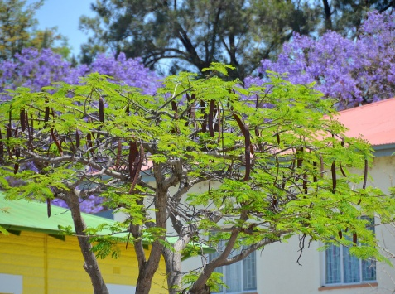

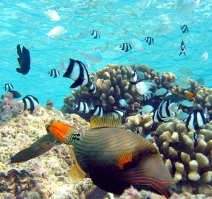
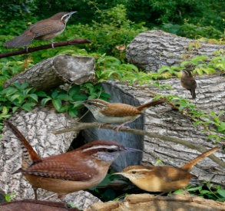
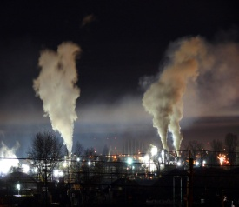


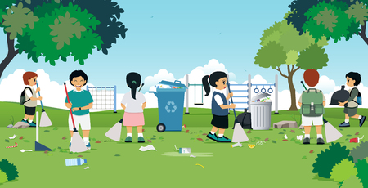


Name: Shweta Sunil Kadam
Roll No : 61291429
World Environment Day
5th June
“Let’s Nurture The Nature So That We Can Have a Better Future”
It Is Not Yours, Nor Mine , It Is Ours. So Protect
Your Mother Who Nourished You.
Keep it Clean Keep it Green
Save Water
Plant more trees and flowers
Don’t pollute environment avoid using vehicles use
This
Rescue Animals and birds
Clean Up
Save Trees
Save Environment
“Every day is environment day, so save your day by saving your environment.”

